Slide 1

DEEP LEARNING BASED TRACEABILITY LINKS RECOVERY APPROACH FOR ISSUE MANAGEMENT
Thazin Win Win Aung (PhD student part-time)
Supervisor - Yulei Sui
Co-supervisor - Huan Huo

Slide 2
Publications
2
T. W. W. Aung, H. Huo and Y. Sui, "A Literature Review of Automatic Traceability Links Recovery for Software Change Impact Analysis," 2020 IEEE International Conference on Program Comprehension (ICPC) https://conf.researchr.org/details/icpc-2020/icpc-2020-research/13/A-Literature-Review-of-Automatic-Traceability-Links-Recovery-for-Software-Change-Impa
T. W. W. Aung, H. Huo and Y. Sui, "Interactive Traceability Links Visualization using Hierarchical Trace Map," 2019 IEEE International Conference on Software Maintenance and Evolution (ICSME), Cleveland, OH, USA, 2019, pp. 367-369, doi: 10.1109/ICSME.2019.00059.
University of Technology Sydney

Slide 3
Introduction
Aims
Methods
Work In progress
Research Timeline
Literature Review
University of Technology Sydney

Slide 4
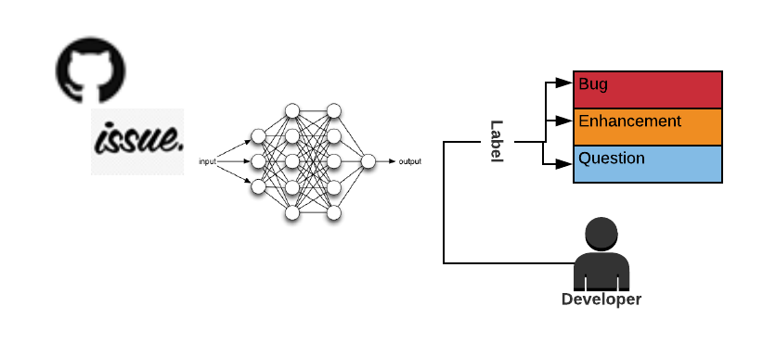
Introduction (1/3)
4
Topic
In open-source software (OSS) development, the developer community predominantly uses web-based issue tracking systems (e.g., GitHub, Bugzilla) to collaborate with users in the collection of different types of software changes (e.g., enhancements, bugs).
Finding the candidate developers and allocating relevant issue types is a non-trivial exercise
University of Technology Sydney

Slide 5
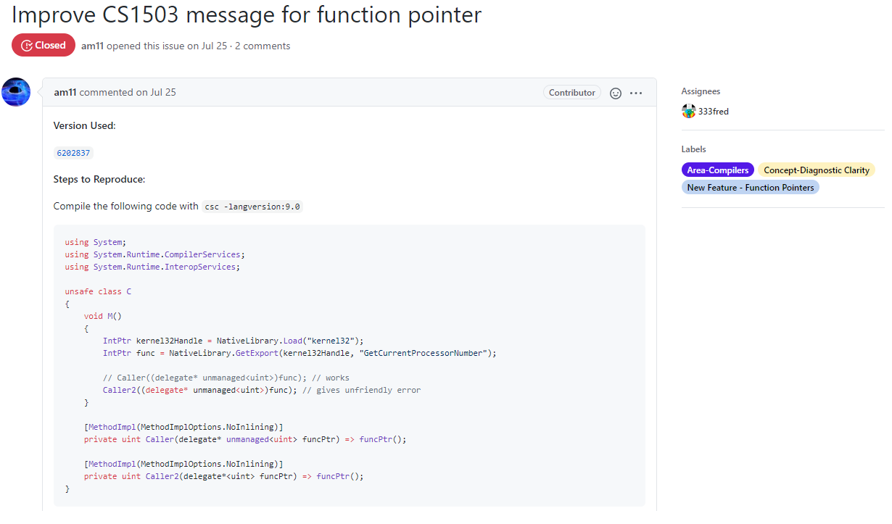
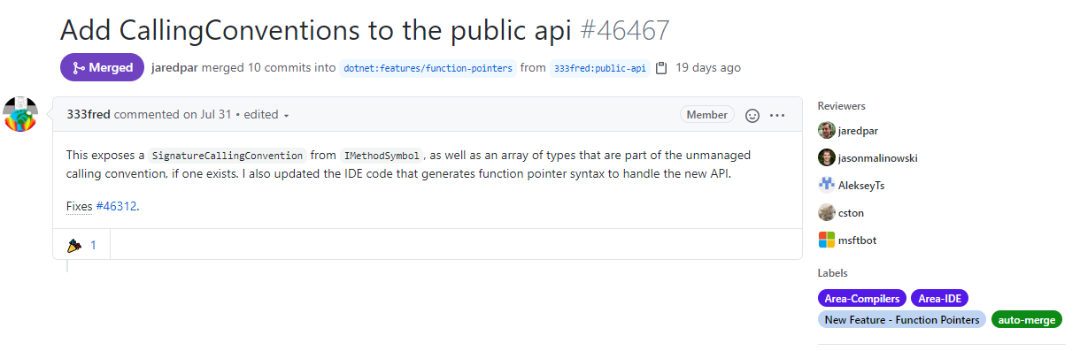
Introduction (2/3)
5
Visualizing the Problem Domain
Issue Request (Created by User )
Pull request (Created By Developer)
University of Technology Sydney

Slide 6
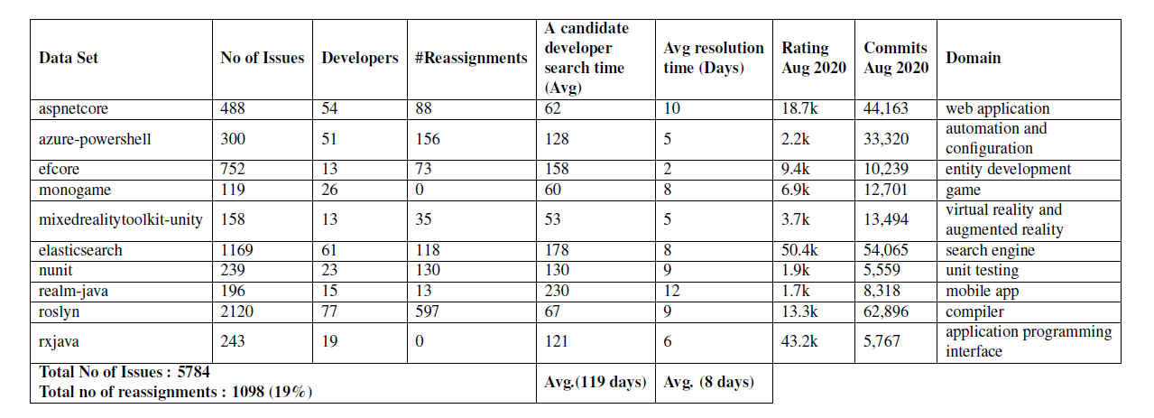
Introduction (3/3)
6
Motivation
University of Technology Sydney

Slide 7
Research Aim
7
Automatic Issue Labelling
Propose a context-ware sentence embedding mechanism to extract the key features from issue reports
Propose a context-ware sentence embedding mechanism based prediction model to recommend relevant developers and issue types for a new issue report
Propose a multi-task learning model to leverage the automatic traceability links recovery approach to accelerate issue triage process
University of Technology Sydney

Slide 8
Literature Review
8

Slide 9
Systematic Literature review (1/7)
9
Systematically review automatic traceability links recovery approaches in a software change impact analysis (CIA) context to identify research gaps and report evidence to direct future research.
CIA - “the assessment of the effect of changes – providing techniques to address the problem by identifying the likely ripple-effect of software changes and using this information to re-engineer the software system design”
SLR guidelines provided by Kitchen-ham and Charters [1] and reviewed the primary studies published during 2012–2019.
University of Technology Sydney

Slide 10
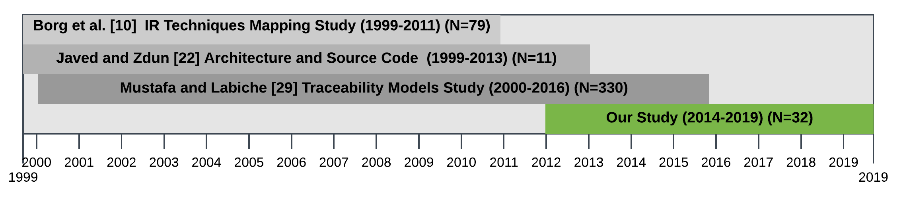
Systematic Literature review (2/7)
10
Existing Works
University of Technology Sydney

Slide 11
Systematic Literature review (3/7)
11
Research Questions
RQ 1. What approaches have been adopted to recover traceability links between artifacts to support CIA?
RQ 2. Which change impact sets have been covered?
RQ 3. How have studies adopted transitive tracing approaches to recover traceability links between artifacts?
Search Criteria
Search Strings
ABSTRACT: (Abstract: trace*)
AND (Abstract: recover* OR Abstract: maintain OR Abstract: link OR Abstract: establish)
AND (Abstract: requirement OR Abstract: specification OR Abstract: architecture OR Abstract: design OR Abstract: code OR Abstract: implementation OR Abstract: test OR Abstract: bug)
AND (Abstract: change OR Abstract: impact OR Abstract: analysis OR Abstract: system comprehension)
Data Sources
ACM, IEEE xplore, Science Direct, SpringerLink, Scopus
University of Technology Sydney

Slide 12
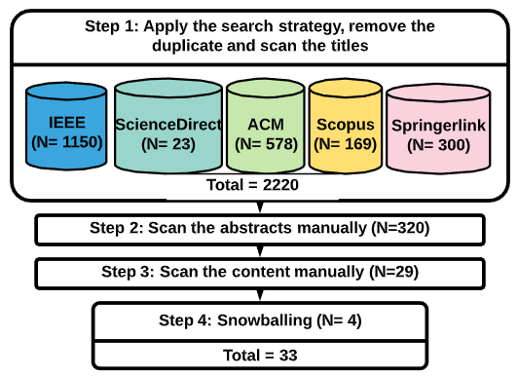

Systematic Literature review (4/7)
12
Selection Criteria
Publication Year (2012 – 2019)
The publications are written in English
Research explicitly mention they are targeting trace recovery relating to software maintenance and change impact analysis
Studies contain empirical results (e.g., case study, experiments and surveys)
Scan Title
Scan Abstract
Scan Content
Forward Snowballing
University of Technology Sydney

Slide 13
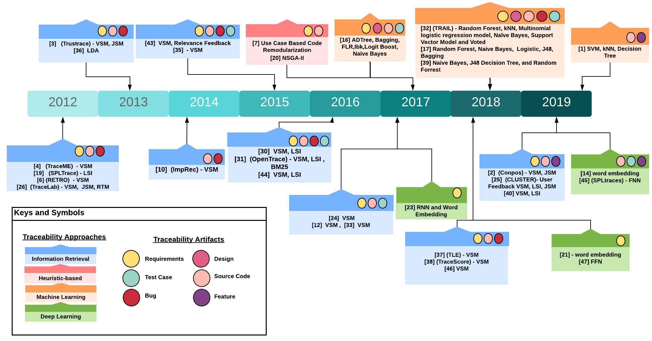
Systematic Literature review (5/7)
University of Technology Sydney
Fig. Traceability Links Recovery Approaches Between Software Artifacts

Slide 14
Systematic Literature review (5/7)
14
Trace Directions
Research Methods
Datasets
University of Technology Sydney

Slide 15
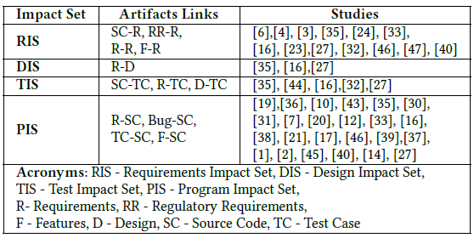
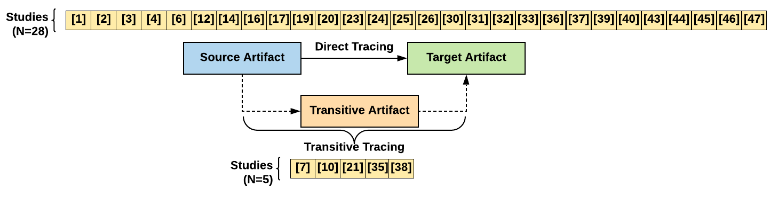
Systematic Literature review (6/7)
15
Change Impact Sets
Traceability Links Recovery Methods
RIS (#13), DIS (#3), TIS (#5), PIS (#24)
University of Technology Sydney

Slide 16
Systematic Literature review (7/7)
16
Research Gap
Very few studies used deep learning techniques to leverage the automation of issue management system
None of the existing studies take into account the abstract syntax tree structure representation of issue report’s code snippet in traceability links recovery approach
None of the existing studies investigated the use of multi-task learning framework to recover the correlation between issue reports and its corresponding categorical variables (e.g., developers, issue types)
University of Technology Sydney

Slide 17
Research Methods

Slide 18
Research Methods
Design Science - “is a problem-solving , which predominately applied in software engineering research seek to find solution space for an unsolved problem or to improve a known problem in more effective and efficient approach”
(Alan R Hevner et al., 2004)

Slide 19
Work In progress Process Model

Slide 20
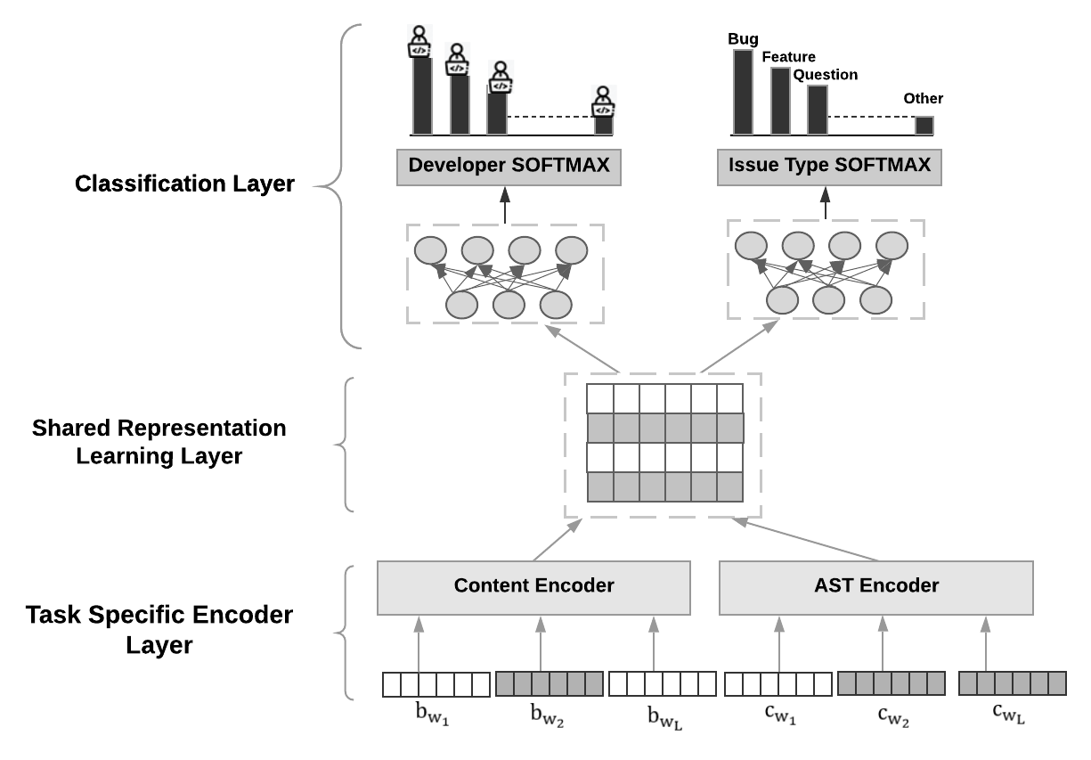
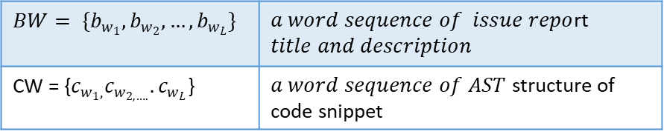
Work In Progress (1/6)
20
High Level Multi-task Automatic Bug Triage Network
Task Specific Encoder Layer - use Joint feature learning approach to learn contextual information for issue report by using two encoders
Shared Representation Layer – Concatenate both representation into one representation
Classification layers – use sequential neutral network to classify the labels (e.g. Developer and Issue Type)
$${BW= \{b_{w_{1}},b_{w_{2}},…,b}_{w_{L}}\}$$ | $a word sequence of issue repo$rt $$title and description$$
CW = {$c_{w_{1},}c_{w_{2,….}}{.c}_{w_{L}}$} | $a word sequence of AST$ structure of code snippet
University of Technology Sydney
Notes:
Multi-Task Learning (MTL) is a learning paradigm in machine learning and its aim is to leverage useful information contained in multiple related tasks to help improve the generalization performance of all the tasks.
A word embedding is a learned representation for text where words that have the same meaning have a similar representation.
In our model, we only focus on sentence level classification. Task specific layer learn the representation of issue report using two encoders. Frist we create two sequence of tokens BW and CW, where L is the length of the sentence. BW sequence token contain word embeddings of issue report’s title and description, whereas CW sequence token contains word embedding of AST structure of code snippet. In word embedding, every word in a sentence is embedded into a d dimensional vectors. After all the word vectors are stacked, an embedding matric MLxd is generated, where d means the embedding size and L denotes the length of sentence. Then we feed these BW word vectors to Content Encoder and CW to AST Encoder.
Embedding Layers Map each word into a low dimension vector.

Slide 21
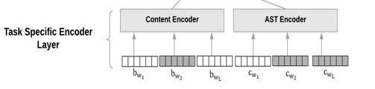
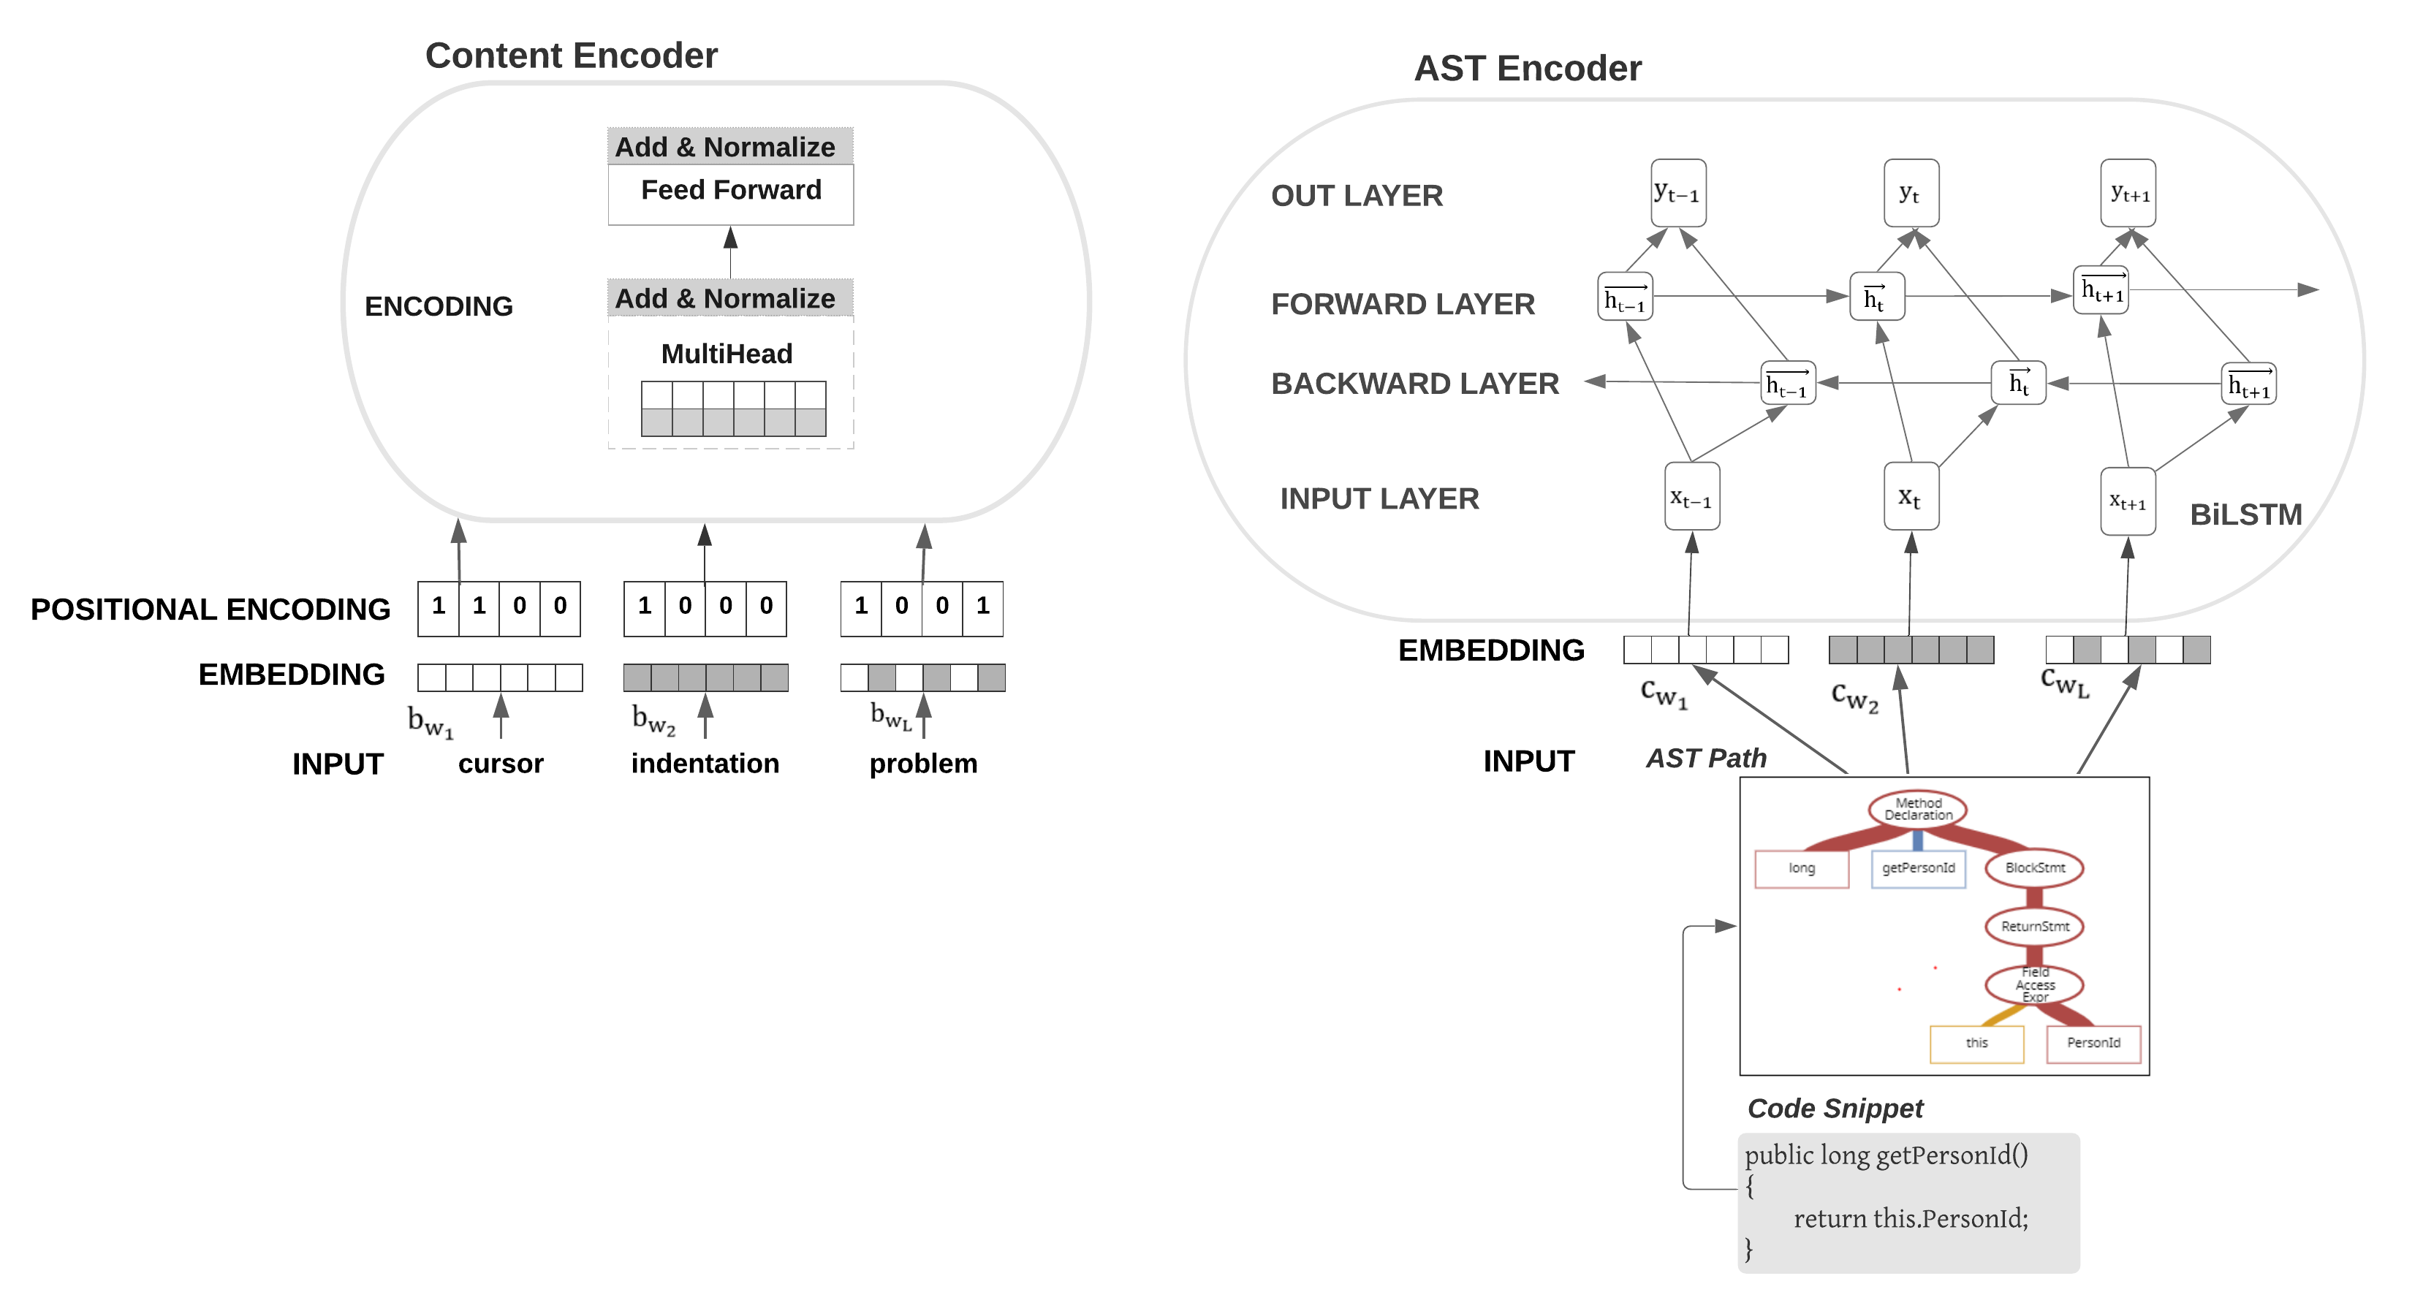
Work In Progress (2/6)
21
Task Specific Encoder Layer
University of Technology Sydney

Slide 22
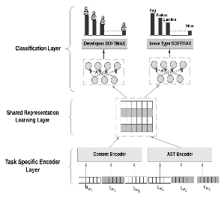










Work In Progress (3/6)
22
Equations
Content Encoder Layer
AST Encoder Layer
Classification Layer
University of Technology Sydney
Notes:
Eq 2 = In our model, we use thesine and cosine functions to establish relative position.
In Eq. 2 and 3,posdenotes position,idenotes dimen-sion, anddmodel= 512.
Once the sine and cosine valuesare calculated, our model concatenates the values intoeach word embedding vectors to retain the positionalinformation

Slide 23
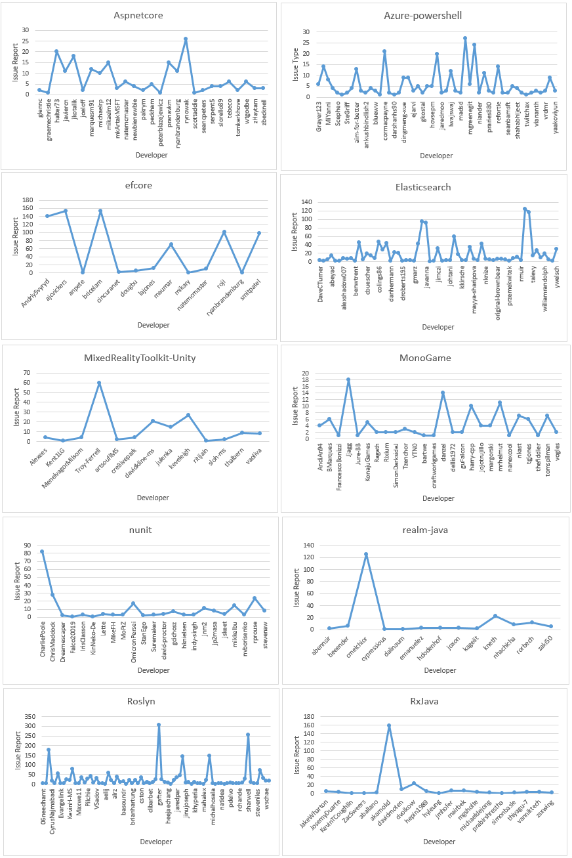
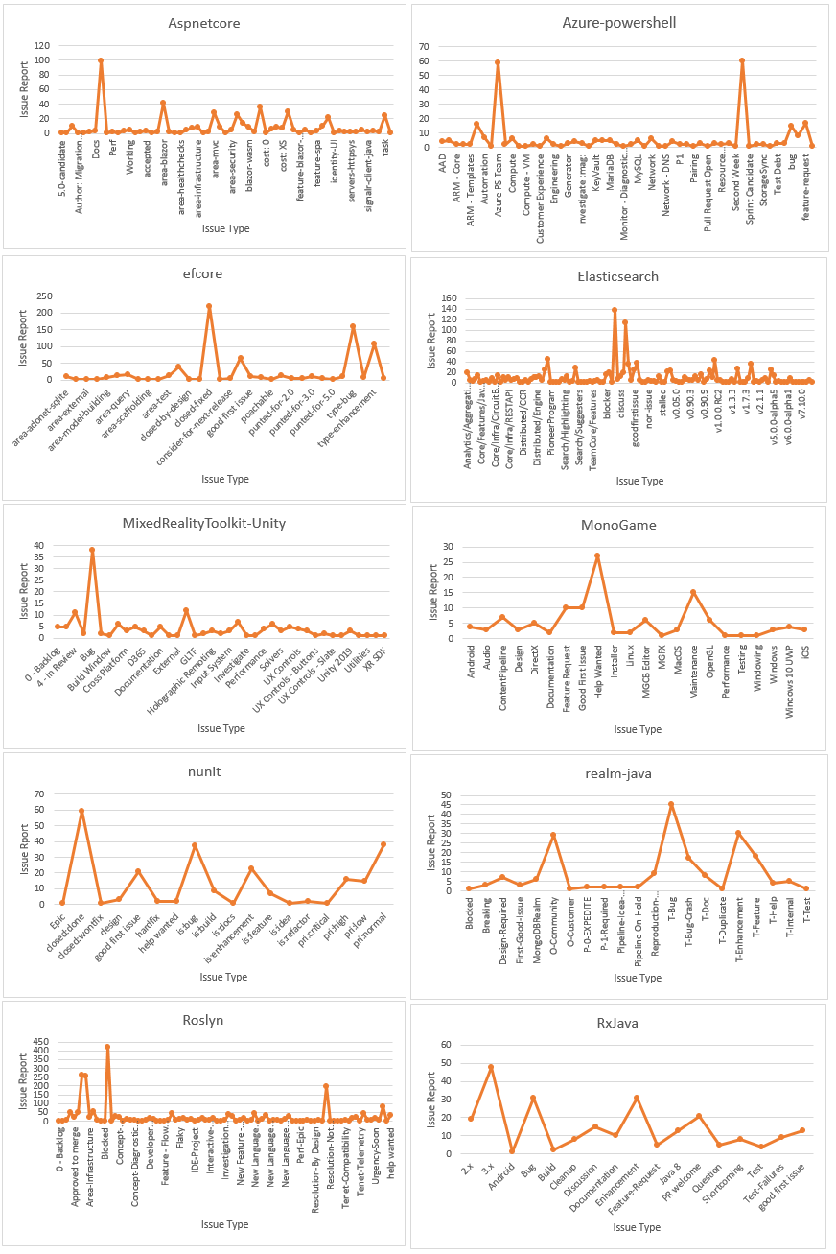
Work In Progress (4/6)
23
Developer distribution across Issue Reports in Datasets
Issue Type distribution across Issue Reports in Datasets
University of Technology Sydney

Slide 24
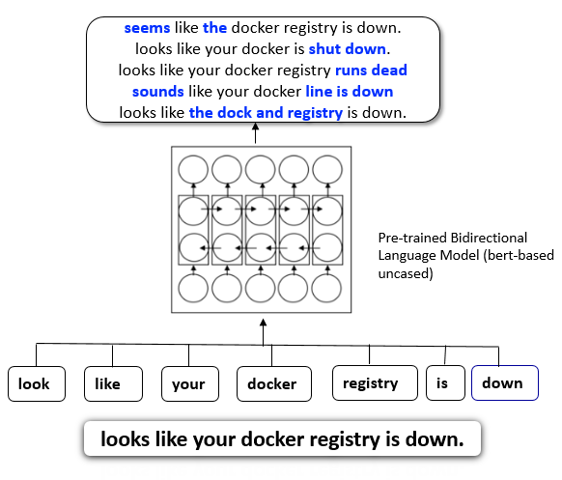
Work In Progress (5/6)
24
Use Contextual Augmentation to Oversample the Datasets
Contextual Augmentation Approach based oversampling – create a new sample record by substitute 15 % of words in an original bug report description by using words predicted by Bidirectional Language model (LM). The model suggests various words that have paradigmatic relations. The model predicts a substitute word by given the surrounding words in the sentence.
Algorithm 2 : Pseudocode for Contextual Augmentation Based Oversampling
1: | Split Train and Test data samples with 80-20 ratio
2: | Take the training data
3: | Get a majority class count( e.g. a class with a highest bug reports count)
4 | Get the list of minority classes
5: | Loop through each minority class , one group at a time until a minority class count match up with a majority class count
 | First take a random record from a minority group Next, extract first 50 words of the bug report description (exclude code snippet) and substitute 15% of these words with contextual augmentation approach Then, concertante the new words with remaining words to create a new synthetic record.
Fig. Contextual Augmentation Approach based oversampling Example
University of Technology Sydney
Notes:
Over-sampling Data – which balanced the data set through increasing the sample of minority class to match up the number of majority
Paradigmatic – mutually exclusive choice

Slide 25
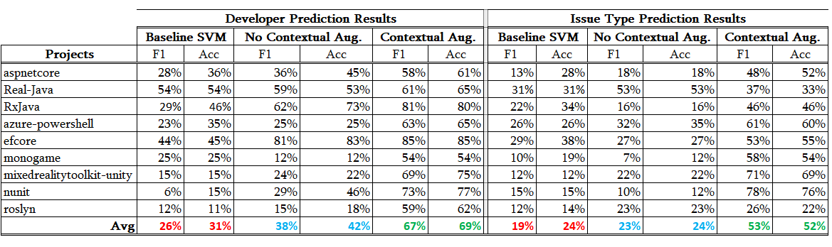
Work In Progress (6/6)
25
Experimental results
University of Technology Sydney
Notes:
Over-sampling Data – which balanced the data set through increasing the sample of minority class to match up the number of majority
Paradigmatic – mutually exclusive choice

Slide 26

THANK YOU Any Questions?
University of Technology Sydney

